Slide 1

Project Presentation 1 ME 609 – Optimisation Methods in Engineering
Bracketing Method: Bounding Phase Method
Accurate Method: Golden Section Search Method
Group No : 7
Nirmal S. [234103107]
Rohith Kumar Saragadam [234103109]

Slide 2
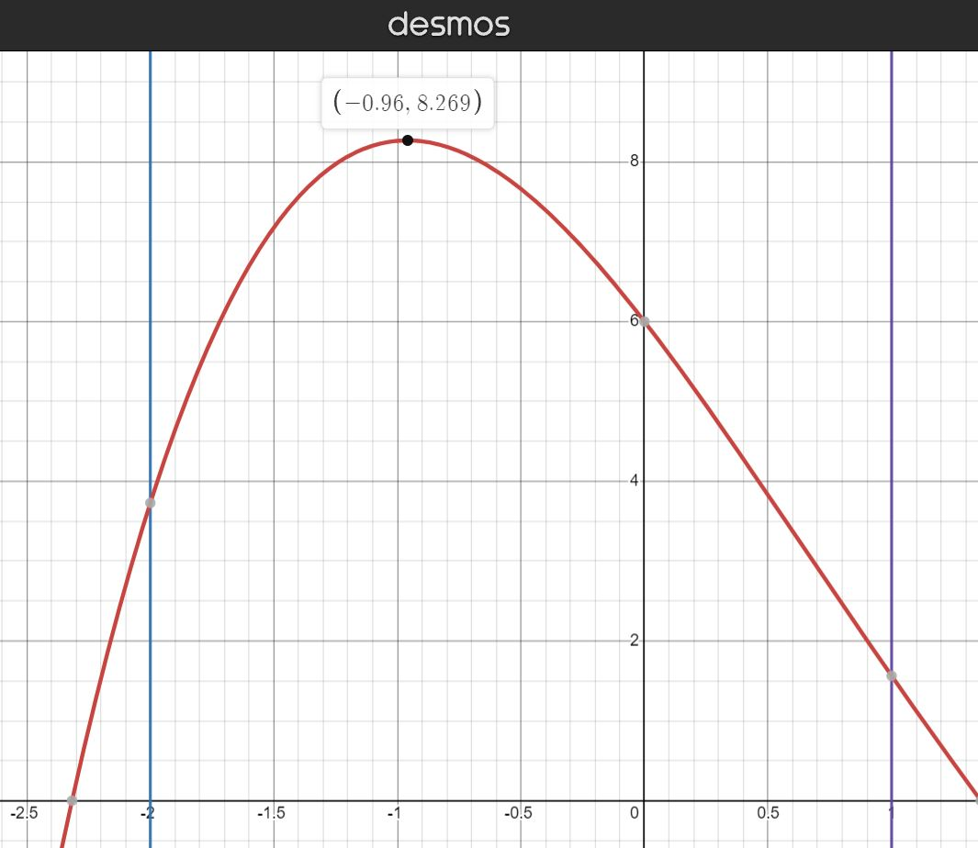
Function: $8+x^{3}−2x−2e^{x}$ in the interval $(−2, 1)$
Plotting the graph on Desmos (online graphing tool) to get an idea of the function we are dealing with.

Slide 3
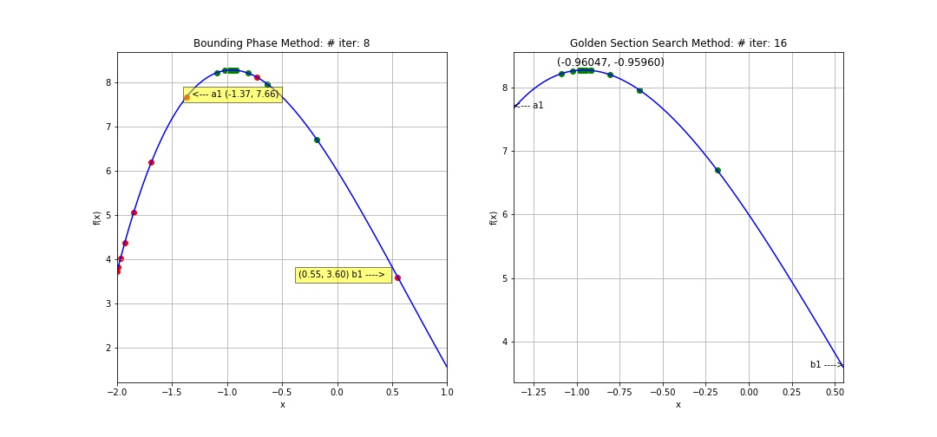
Function: $8+x^{3}−2x−2e^{x}$ in the interval $(−2, 1)$
The bracketing achieved by providing the following inputs:
$\left(a, b\right)=\left(−2, 1\right)$ $x\left(0\right)=−2$ (initial guess)
$delta=0.01$ $ε={10}^{−3}$

Slide 4
Function: $8+x^{3}−2x−2e^{x}$ in the interval $(−2, 1)$
Bounding Phase Method Iterations:
k | iter | x_k | x_(k+1) | f(x_k) | f(x_(k+1)) | Continue/Terminate
0 | 1 | -2 | -1.99 | 3.729329 | 3.82601 | Continue
1 | 2 | -1.99 | -1.97 | 3.82601 | 4.015713 | Continue
2 | 3 | -1.97 | -1.93 | 4.015713 | 4.380647 | Continue
3 | 4 | -1.93 | -1.85 | 4.380647 | 5.053901 | Continue
4 | 5 | -1.85 | -1.69 | 5.053901 | 6.184152 | Continue
5 | 6 | -1.69 | -1.37 | 6.184152 | 7.660433 | Continue
6 | 7 | -1.37 | -0.73 | 7.660433 | 8.107165 | Continue
7 | 8 | -0.73 | 0.55 | 8.107165 | 3.599869 | Terminate

Slide 5
Function: $8+x^{3}−2x−2e^{x}$ in the interval $(−2, 1)$
aw | bw | lw | w1 | w2 | f(w1) | f(w2) | Continue/Terminate | Iter | a1 | b1
0 | 1 | 1 | 0.618 | 0.382 | 6.695904 | 7.956962 | Continue | 1 | -1.370 | 0.550
0 | 0.618 | 0.618 | 0.381924 | 0.236076 | 7.95723 | 8.263398 | Continue | 2 | -1.370 | -0.183
0 | 0.381924 | 0.381924 | 0.236029 | 0.145895 | 8.263423 | 8.212644 | Continue | 3 | -1.370 | -0.637
0.145895 | 0.381924 | 0.236029 | 0.291761 | 0.236058 | 8.198676 | 8.263408 | Continue | 4 | -1.090 | -0.637
0.145895 | 0.291761 | 0.145866 | 0.23604 | 0.201616 | 8.263417 | 8.26778 | Continue | 5 | -1.090 | -0.810
0.145895 | 0.23604 | 0.090145 | 0.201605 | 0.18033 | 8.267776 | 8.256047 | Continue | 6 | -1.090 | -0.917
0.18033 | 0.23604 | 0.05571 | 0.214759 | 0.201612 | 8.269458 | 8.267778 | Continue | 7 | -1.024 | -0.917
0.201612 | 0.23604 | 0.034429 | 0.222888 | 0.214763 | 8.268415 | 8.269458 | Continue | 8 | -0.983 | -0.917
0.201612 | 0.222888 | 0.021277 | 0.214761 | 0.209739 | 8.269458 | 8.269311 | Continue | 9 | -0.983 | -0.942
0.209739 | 0.222888 | 0.013149 | 0.217865 | 0.214762 | 8.269246 | 8.269458 | Continue | 10 | -0.967 | -0.942
0.209739 | 0.217865 | 0.008126 | 0.214761 | 0.212843 | 8.269458 | 8.269474 | Continue | 11 | -0.967 | -0.952
0.209739 | 0.214761 | 0.005022 | 0.212843 | 0.211658 | 8.269474 | 8.269439 | Continue | 12 | -0.967 | -0.958
0.211658 | 0.214761 | 0.003104 | 0.213576 | 0.212843 | 8.269478 | 8.269474 | Continue | 13 | -0.964 | -0.958
0.212843 | 0.214761 | 0.001918 | 0.214029 | 0.213576 | 8.269474 | 8.269478 | Continue | 14 | -0.961 | -0.958
0.212843 | 0.214029 | 0.001185 | 0.213576 | 0.213296 | 8.269478 | 8.269478 | Continue | 15 | -0.961 | -0.959
0.213296 | 0.214029 | 0.000733 | 0.213749 | 0.213576 | 8.269477 | 8.269478 | Terminate | 16 | -0.960 | -0.959
Golden Section Search Method

Slide 6
Function: $8+x^{3}−2x−2e^{x}$ in the interval $(−2, 1)$
Extracting data by running the program for iterations changing x(0), epsilon and delta
a | b | l | x(0) | delta | Bounding Iterations | a1 | b1 | l1 | epsilon | Golden Section Iterations | final_a | final_b | final_l
-2 | 1 | 3 | -2 | 0.01 | 8 | -1.37 | 0.55 | 1.92 | 0.001 | 16 | -0.96047 | -0.9596 | 0.000869
-2 | 1 | 3 | -1.8 | 0.01 | 7 | -1.49 | -0.53 | 0.96 | 0.001 | 16 | -0.96026 | -0.95982 | 0.000435
-2 | 1 | 3 | -1.6 | 0.01 | 7 | -1.29 | -0.33 | 0.96 | 0.001 | 16 | -0.96024 | -0.9598 | 0.000435
-2 | 1 | 3 | -1.4 | 0.01 | 6 | -1.25 | -0.77 | 0.48 | 0.001 | 16 | -0.96022 | -0.96 | 0.000217
-2 | 1 | 3 | -1.2 | 0.01 | 6 | -1.05 | -0.57 | 0.48 | 0.001 | 16 | -0.96025 | -0.96003 | 0.000217
-2 | 1 | 3 | -1 | 0.01 | 3 | -0.99 | -0.93 | 0.06 | 0.001 | 16 | -0.96017 | -0.96014 | 0.0000272
-2 | 1 | 3 | -0.8 | 0.01 | 5 | -0.87 | -1.11 | 0.24 | 0.001 | 16 | -0.96011 | -0.96022 | 0.00011
-2 | 1 | 3 | -0.6 | 0.01 | 6 | -0.75 | -1.23 | 0.48 | 0.001 | 16 | -0.96001 | -0.96022 | 0.00022
-2 | 1 | 3 | -1.4 | 0.01 | 6 | -1.25 | -0.77 | 0.48 | 0.0001 | 21 | -0.96016 | -0.96014 | 1.96E-05
-2 | 1 | 3 | -1.4 | 0.01 | 6 | -1.25 | -0.77 | 0.48 | 0.00001 | 25 | -0.96015 | -0.96015 | 2.86E-06
-2 | 1 | 3 | -1.4 | 0.01 | 6 | -1.25 | -0.77 | 0.48 | 0.01 | 11 | -0.96114 | -0.95873 | 0.002411
-2 | 1 | 3 | -1.6 | 0.1 | 4 | -1.3 | -0.1 | 1.2 | 0.001 | 16 | -0.96051 | -0.95996 | 0.000543
-2 | 1 | 3 | -1.6 | 0.05 | 5 | -1.25 | -0.05 | 1.2 | 0.001 | 16 | -0.96038 | -0.95984 | 0.000543
-2 | 1 | 3 | -1.6 | 0.005 | 8 | -1.285 | -0.325 | 0.96 | 0.001 | 16 | -0.96033 | -0.9599 | 0.000435
-2 | 1 | 3 | -1.6 | 0.001 | 10 | -1.345 | -0.577 | 0.768 | 0.001 | 16 | -0.96036 | -0.96001 | 0.000348

Slide 7

Function: $8+x^{3}−2x−2e^{x}$ in the interval $(−2, 1)$
a | b | l | x(0) | delta | Bounding Iterations | a1 | b1 | l1
-2 | 1 | 3 | -2 | 0.01 | 8 | -1.37 | 0.55 | 1.92
-2 | 1 | 3 | -1.8 | 0.01 | 7 | -1.49 | -0.53 | 0.96
-2 | 1 | 3 | -1.6 | 0.01 | 7 | -1.29 | -0.33 | 0.96
-2 | 1 | 3 | -1.4 | 0.01 | 6 | -1.25 | -0.77 | 0.48
-2 | 1 | 3 | -1.2 | 0.01 | 6 | -1.05 | -0.57 | 0.48
-2 | 1 | 3 | -1 | 0.01 | 3 | -0.99 | -0.93 | 0.06
-2 | 1 | 3 | -0.8 | 0.01 | 5 | -0.87 | -1.11 | 0.24
-2 | 1 | 3 | -0.6 | 0.01 | 6 | -0.75 | -1.23 | 0.48
Changing initial guess $x(0)$ for
Bounding Phase Method

Slide 8
Function: $8+x^{3}−2x−2e^{x}$ in the interval $(−2, 1)$
a | b | l | x(0) | delta | Log Delta | Bounding Iterations | a1 | b1 | l1
-2 | 1 | 3 | -1.6 | 0.1 | -1.0 | 4 | -1.3 | -0.1 | 1.2
-2 | 1 | 3 | -1.6 | 0.05 | -1.3 | 5 | -1.25 | -0.05 | 1.2
-2 | 1 | 3 | -1.6 | 0.01 | -2.0 | 7 | -1.29 | -0.33 | 0.96
-2 | 1 | 3 | -1.6 | 0.005 | -2.3 | 8 | -1.285 | -0.325 | 0.96
-2 | 1 | 3 | -1.6 | 0.001 | -3.0 | 10 | -1.345 | -0.577 | 0.768
Changing delta for
Bounding Phase Method

Slide 9
Function: $8+x^{3}−2x−2e^{x}$ in the interval $(−2, 1)$
a1 | b1 | l1 | epsilon | Log(epsilon) | Golden Section Iterations | final_a | final_b | final_l | Final L
-1.25 | -0.77 | 0.48 | 0.01000 | -2 | 11 | -0.96114 | -0.95873 | 0.002411 | 2410.54
-1.25 | -0.77 | 0.48 | 0.00100 | -3 | 16 | -0.96022 | -0.96 | 0.000217 | 217.30
-1.25 | -0.77 | 0.48 | 0.00010 | -4 | 21 | -0.96016 | -0.96014 | 0.000020 | 19.59
-1.25 | -0.77 | 0.48 | 0.00001 | -5 | 25 | -0.96015 | -0.96015 | 0.000003 | 2.86
Changing epsilon for
Golden Section Search Method

Slide 10
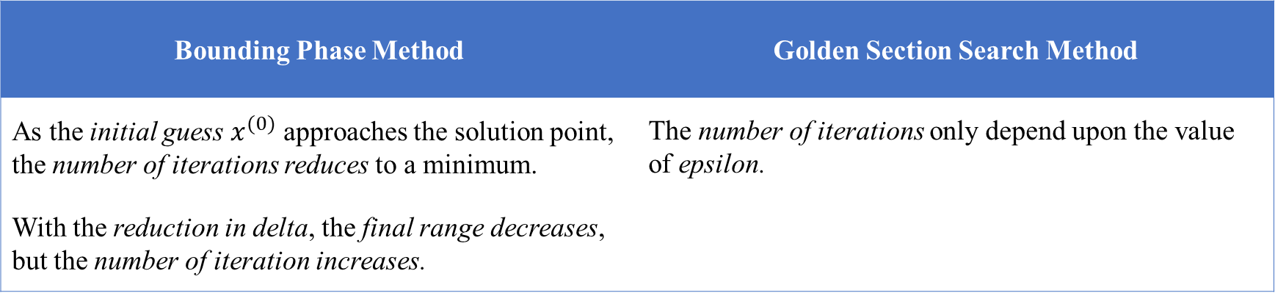
Results and Observation
Bounding Phase Method | Golden Section Search Method
As the initial guess $x^{(0)}$ approaches the solution point, the number of iterations reduces to a minimum. | The number of iterations only depend upon the value of epsilon.
With the reduction in delta, the final range decreases, but the number of iteration increases.

Slide 11
Thank you

